Slide 1
Virtual … It’s for Real!
Edward Fry, MD, FACC
Chair, St. Vincent Health and Ascension CVSL
Indianapolis, IN
Trustee, American College of Cardiology

Slide 2
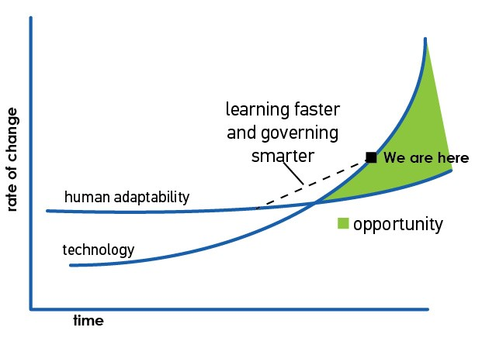
Acceleration of Change: Eric “Astro” Teller’s Curve
Change as the new constant:
COVID-19
“Thank You for Being Late” – Thomas Freidman, 2016, p. 34

Slide 3
Goals for changes in practice:
Ascension CVSL Update
Reduce risk of infection and spread of COVID-19
  “Flatten the Curve”
Patient safety
Care team safety
Protect critical workforce/Preserve PPE
Keep patients at home
Mitigate Financial Impact
Learn: Use current experience to drive future care transformation
Adapt to changing facts and events
Preserve access to care, highest quality of care, but in operate in the public interest!

Slide 4
Launching a “Virtual First” Strategy
Clinician engagement: Triage to virtual care
Joint decision making:
  Deferred f/u vs Traditional F2F office care vs Virtual Visits
EHR integration
  Documentation, compliance, medicolegal issues
Provider to provider e-Consults:
  ED, PCP’s, other specialists
F/U and accommodating for deferred care and
  ”Tee-ing it up”

Slide 5
Planning: Operational Considerations
Assessing patient resources and capabilities
Standardizing video platforms:
  Balance Patient vs System Efficiencies
Staff workflows to replicate a typical office visit
Considerations for outreach or regional care
  Standardization across continuum
Planning for a "Post-COVID World" –
  Telemedicine here to stay

Slide 6
A Brave New (Virtual) World …
CVSL Practice Update
“Never let a good crisis go to waste” – Rahm Emanuel
“Let them say … this was their finest hour” - Winston Churchill
No going back … “Virtual for the Virus, then Virtual for Value”
This is changing hour to hour
Be safe
Be flexible
Be kind
Be ready

